Slide 1

Generative models Sarah Pederzani StalFire PSM workshop, University of Utah 18.01.2025

Slide 2
What is a generative model?
A generative model is any set of rules about how to produce an outcome expressed as a mathematical or computational model
α τ κ ε
Parameters
Computer program
Mathematical expression
Set of rules
Generative model
Data
x | y | group
1.34 | 0.22 | A
7.16 | 4.32 | B

Slide 3
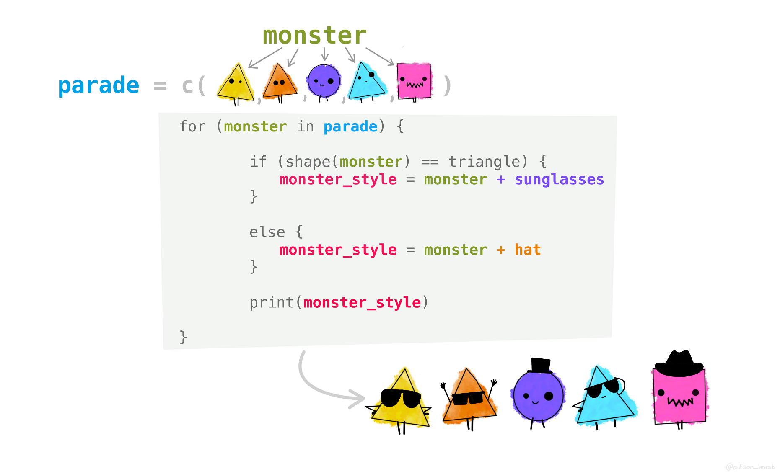
What is a generative model?
A generative model is any set of rules about how to produce an outcome expressed as a mathematical or computational model
Parameters
Triangular monsters get sunglasses
Other monsters get hats
Generative model
Data
Art by Allison Horst

Slide 4
What is a generative model?
A generative model is any set of rules about how to produce an outcome expressed as a mathematical or computational model
Art by Allison Horst

Slide 5
Generative model concept
Generative models predict what future data may look like by using known parameters and the mathematical rules of the model
Input observations
State for which we generate new data
Parameters
known values
Generative model
Synthetic data
predicted data

Slide 6

The role of simulations
Simulations represent randomness in the input and the model process by using random number generators in computational implementations of the model
random draws
Input observations
Parameters
Generative model
Synthetic data

Slide 7
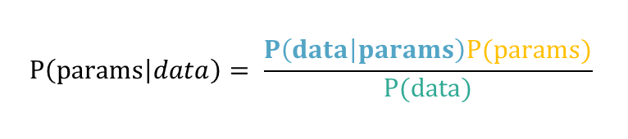
Generative models as part of Bayesian inference
Likelihood
Prior
Parameters
Bayesian inference
$$P\left(params | data\right)= \frac{P\left(data | params\right)P(params)}{P(data)}$$
Generative model
Posterior
Normalizing
constant
Data
Bayesian inference uses a generative model to establish the probability of the data given the parameters
(Likelihood function)

Slide 8



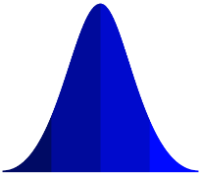



Why run a simulation first?
Simulations are much faster and easier to run and interrogate. The are therefore useful for exploratory experiments.
Debugging
Reality checks
Sensitivity experiments
Thought experiments
Does it run?
Is the output reasonable?
How does the output respond?
What happens if…?
Input 2
Input
Q
Input 1
Input 3
Model 1
Model 2
Output 2
S
Negative water flow?
Output 1
Output 3
Output 1
Output 2

Slide 9

Let’s dive in!

